Slide 1
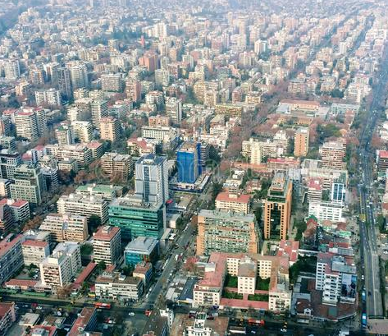
Urbanization, Economic Development and CO2 Emissions
Jarle Kvile

Slide 2
Dataset
This project uses the “World Development Indicators” dataset, made available by the World Bank.
This is a large dataset, having almost 5.7 million records.
The data is collected to provide a measure of how the countries of the world are developing according to numerous criteria over time.
The dataset provides us with information from 1960 – 2015, but not all countries have data for all those years.

Slide 3
Motivation
A lot of developed countries experience a migration from rural to urban areas. This is well documented, and coherent with economic theory of economic development.
There are many implications to urbanization. The focus point of economic policies, infrastructure etc. Whether urbanization has a net positive or negative effect is a complicated issue, but this project begins to look at its relation with GDP and CO2-emissions.
The comparison between the OECD and Latin America can add further insight – do we see a common trend?
The data can be used to inform and inspire further research for larger projects. E.g. : How to maximize growth and minimize emissions?

Slide 4
Research Questions
What is the relationship between rural and urban population change and GDP in the OECD member states?
How does this compare to the Latin-American and Caribbean countries, nations with a high income inequality?
What is the relationship between rural and urban population change and CO2 emissions in the OECD?
How does the relationship between population growth and Emissions compare between the OECD and Latin America?

Slide 5
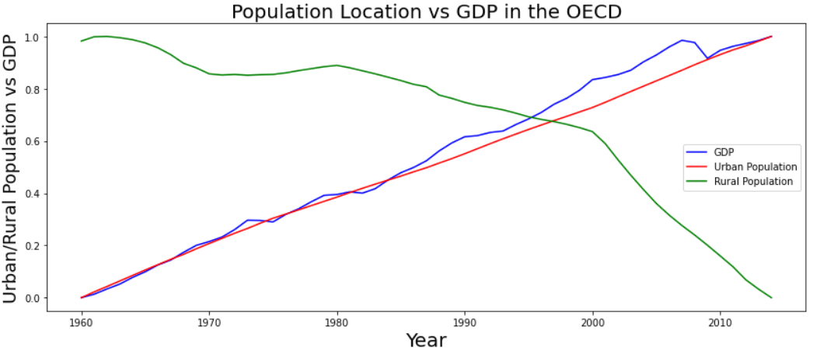
Findings OECD
The plot has been normalized to greater show the relation between the figures
The Urban population have grown by 526 million, while the rural have declined by 42 million
Clearly, GDP growth and urban population growth are strongly correlated. This is, however, a complicated relationship due to socioeconomic and enviromental factors. The extent of which all factors influence eachother requires further research.

Slide 6
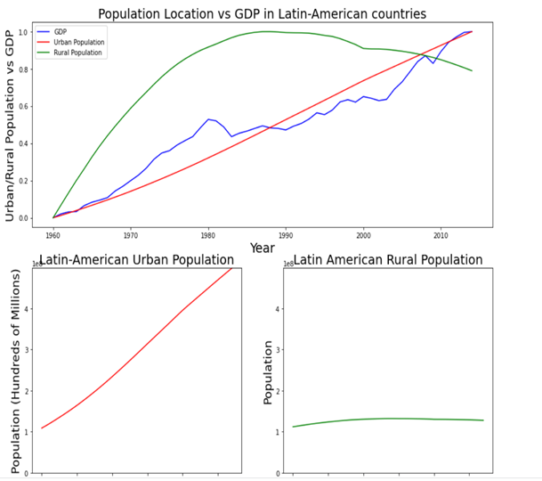
Findings Latin-America and Caribbean countries
The plot has been normalized to greater show the relation between the figures
The Urban Population has had a steady increase, while the rural population is declining in recent years.
Correlation between urban population growth and GDP is here strong too.
For a deeper understanding of these changes, it is useful to compare this with the magnitude of changes with the OECD members.

Slide 7
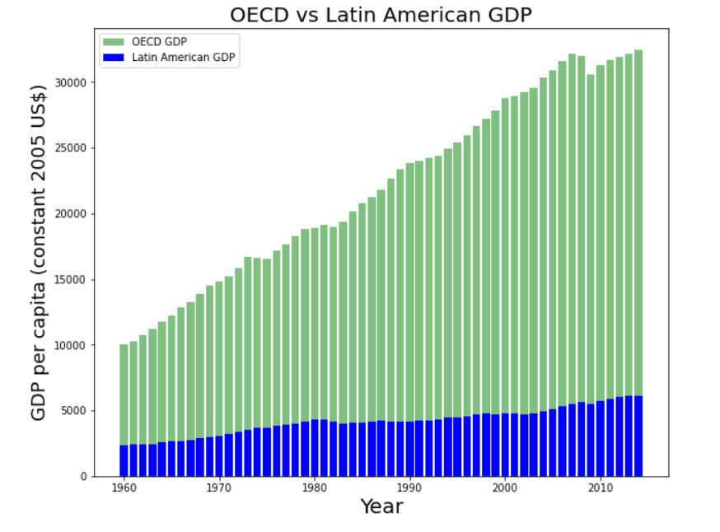
Scale of OECD vs Latin-American GDP change
So, despite previous figures showing a growth in the GDP for the Latin-American and Caribbean countries, the scale here is very different from the OECD member states.
Consistent growth in the OECD, with only a short fall in the periods of financial crisis (such as in 2008)
This figure highlights how far behind the Latin-American and Carribean countries are compared to the OECD members. (and may be why a lot wants to join)

Slide 8
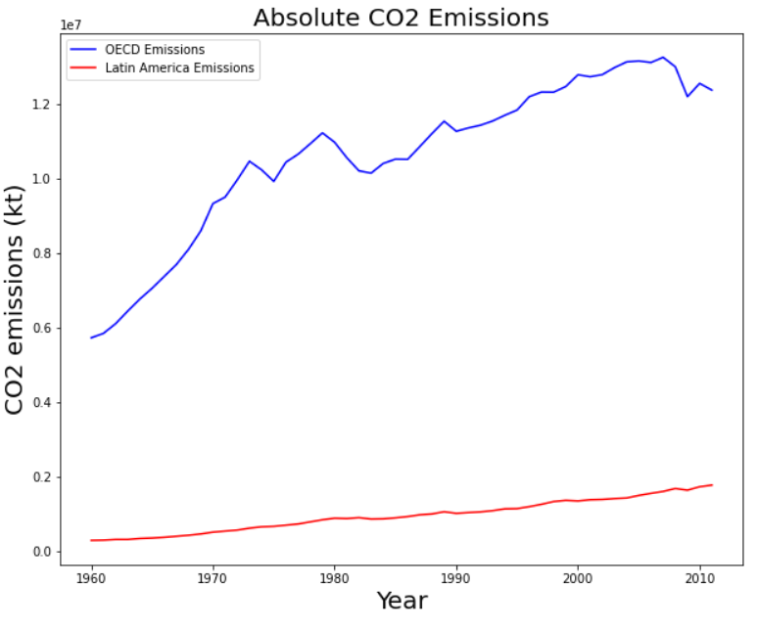
Absolute CO2 Emissions
There has been an increasing trends for both groups since 1960.
The increase has been higher in the OECD than in Latin America, but the trend is declining since mid 2000s.
It is a concern that emissions are rising in the Latin America.As countries develop, sustainability should be built-in to the economies, so emissions do not reach the levels of developed countries like those in the OECD

Slide 9
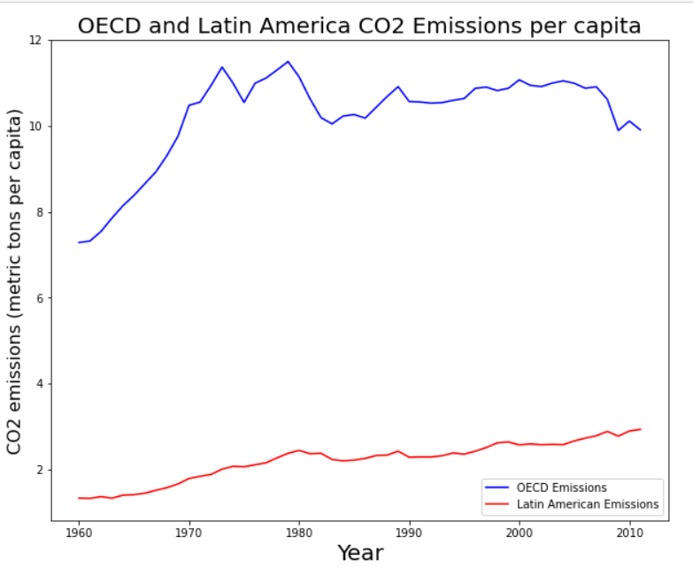
CO2 Emissions as a Proportion of Capita
The figure does not provide us with maybe as an encouraging narrative as some might have hoped.
We do observe that the emissions in the OECD countries were highest between 1970 - 1980 per capita, and have been declining since the mid 2000s, but are still a lot higher than for the Latin American countries.

Slide 10
Final remarks
The relations between population changes, urbanization, GDP and Emissions are a huge topic for a master thesis, and maybe even an entire PhD. There are many more aspects to investigate here, and the mini project could not handle that.
However, there are many interesting findings in the data set.
We do observe that the rural population is declining, and the urban population in the OECD is increasing in the rate of the rise in GDP
We do observe that the OECD GDP is increasing steadily, while the Latin-American region does not have the same stabile growth.
How will the new technology, especially now since the COVID-19 outbreak, influence remote working and the rural population? There are a huge boom in jobs as data scientists, and many of them offer a remote working location. How this will affect emissions, also with the rise in data mining, will be important to follow closely.

Slide 11
Acknowledgements
I would like to acknowledge the World Bank for making such complete and high-quality data available
I would also like to acknowledge my peers who will review this work, and the staff at UCSD and EdX for providing this Data Science Micromasters
Lastly, I would like to thank Jo-Thori Lind, Faculty of Economics at the University of Oslo, for providing inspiring lectures, that are still with me, 7 years later.

Slide 12
References
Inspirations:
Harris, John R. & Todaro, Michael P. (1970), "Migration, Unemployment and Development: A Two-Sector Analysis", American Economic Review, 60 (1): 126–142, JSTOR 1807860
Chen Jiong (1994), "The Harris-Todaro Model of Labor Migration and Its Commercial Policy Implications". Iowa State University.
All the work of the actual project is my own.

